Slide 1
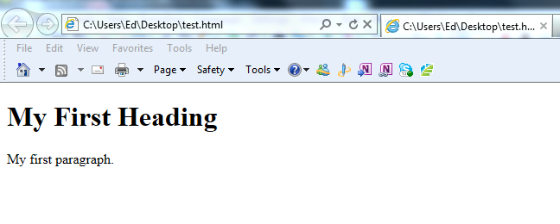
My First Webpage
<!DOCTYPE html> < html> < body> < h1>My First Heading</h1> < p>My first paragraph.</p> < /body> < /html>
<!DOCTYPE html>
<!--This is a comment. --> < html> <!– This is a tag --> < body> <!-- Start Body tag --> < /body> <!-- End body tag --> < /html> <!-- End html tag-->

Slide 2
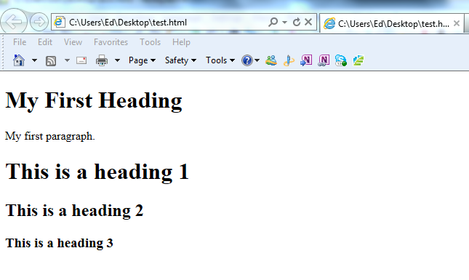
HTML Headings
HTML headings are defined with the <h1> to <h6> tags.
<!DOCTYPE html>
<!--This is a comment. --> < html> <!– This is a tag --> < body> <!-- Start Body tag -->
<h1>This is a heading 1</h1> < h2>This is a heading 2</h2> < h3>This is a heading 3</h3>
< /body> <!-- End body tag --> < /html> <!-- End html tag-->

Slide 3
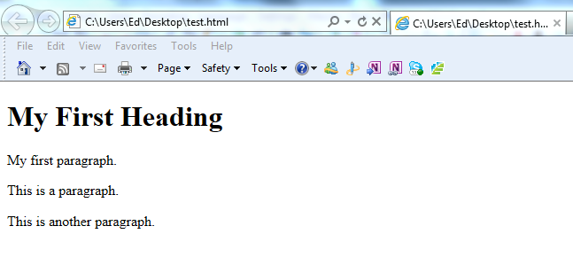
HTML Paragraphs
HTML paragraphs are defined with the <p> tag.
<!DOCTYPE html>
<!--This is a comment. --> < html> <!– This is a tag --> < body> <!-- Start Body tag -->
<p>This is a paragraph.</p> < p>This is another paragraph.</p> < /body> <!-- End body tag --> < /html> <!-- End html tag-->

Slide 4
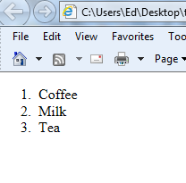
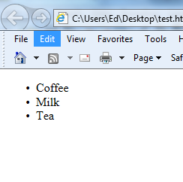
HTML Lists
An ordered list:
1. The first list item
2. The second list item
3. The third list item
An unordered list:
List item
List item
List item
<ol> < li>Coffee</li> < li>Milk</li>
<li>Tea</li> < /ol>
<ul> < li>Coffee</li> < li>Milk</li>
<li>Tea</li> < /ul>

Slide 5
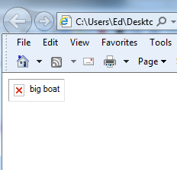
HTML Images
HTML images are defined with the <img> tag.
To display an image on a page, you need to use the src attribute. Src stands for "source". The value of the src attribute is the URL (location) of the image you want to display. The alt value is required as this is what will be displayed if we cannot find or display the image
<!DOCTYPE html>
<!--This is a comment. --> < html> <!– This is a tag --> < body> <!-- Start Body tag -->
<img src="http://www.w3schools.com/images/boat.gif" alt=“big boat"> < /body> <!-- End body tag --> < /html> <!-- End html tag-->

Slide 6
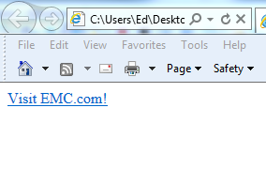
HTML Links
HTML Links are defined with the <a> tag.
The <a> tag defines a hyperlink, which is used to link from one page to another.
The most important attribute of the <a> element is the href attribute, which indicates the link’s destination
<!DOCTYPE html>
<!--This is a comment. --> < html> <!– This is a tag --> < body> <!-- Start Body tag -->
<a href="http://www.emc.com">Visit EMC.com!</a> < /body> <!-- End body tag --> < /html> <!-- End html tag-->

Slide 7
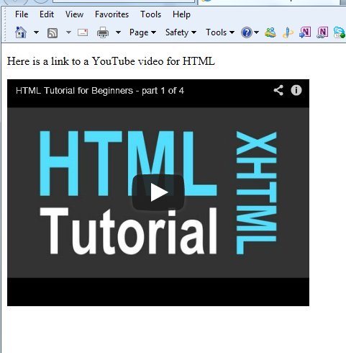
HTML YouTube Video’s
HTML YouTube videos are defined with the <iframe> or <embed> tag.
<!DOCTYPE html>
<!--This is a comment. --> < html> <!– This is a tag --> < body> <!-- Start Body tag -->
<p> Here is a link to a YouTube video for HTML</p>
<iframe width="420" height="315" src="http://www.youtube.com/embed/v4oN4DuR7YU" frameborder="0" allowfullscreen></iframe> < /body> <!-- End body tag --> < /html> <!-- End html tag-->

Slide 8
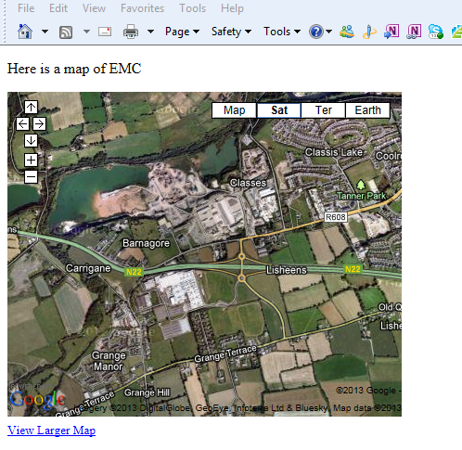
HTML Google Map
You can add google maps to your webpage by going to the following link
http://maps.google.ie/help/maps/getmaps/plot-one.html
This will display instructions

Slide 9
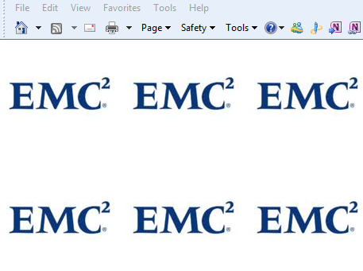
HTML Background Image
In HTML5 we use CSS to have a background image to the page
<!DOCTYPE html>
<!--This is a comment. --> < html> <!– This is a tag --> < body style="background-image:url(emc.jpg)" > <!-- Start Body tag -->
< /body> <!-- End body tag --> < /html> <!-- End html tag-->

Slide 10
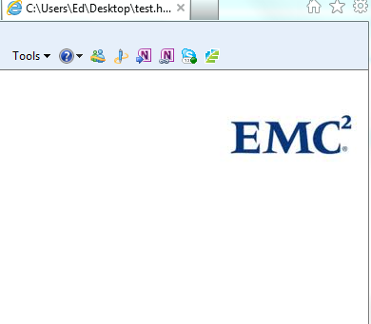
HTML Background Image-2
Now we can decide how and where to put the image
<!DOCTYPE html>
<!--This is a comment. --> < html> <!– This is a tag --> <body
style="background-image:url(emc.jpg);background-repeat:no-repeat;background-position:right top"> <!-- Start Body tag -->
< /body> <!-- End body tag --> < /html> <!-- End html tag-->

